Slide 1

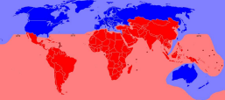
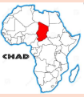
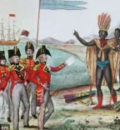
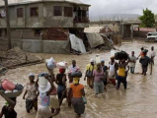
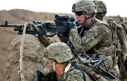
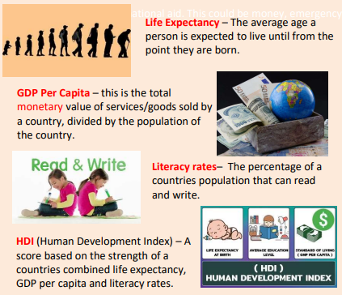

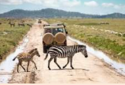



Year 8 Development
This unit focuses on introducing the key concepts of development, exploring indicators of development, causes of uneven development and potential solutions.
Game Changer – ‘I can use my understanding of development indicators and socio-economics to understand differing levels of development and suggest viable methods to reduce the development gap.’
Development | Means people reaching an acceptable standard of living or quality of life
Demographic Transition Model (DTM) | A model shows changes over time in the population of a country
Population Pyramid | A type of a graph which shows the percentage, or number, of males and females in each group
Life expectancy | The average number of years a person is expected to live in a particular place
Human development Index (HDI) | A composite indicator that made up which is made up of a number of three elements (GNI per capita, life expectancy and education) to measure development
Inequality | The difference in circumstances (the lack of equality)
Global Development
Uneven Development
The level of development of a country shows how economically, socially, culturally or technologically advanced that country is.
Unfortunately, some countries are more developed than others. This can happen because of a variety of reasons.
 | Physical Geography Some countries are landlocked and can’t access the sea. This makes trade difficult
 | Historical Causes Some countries have experienced war or colonialism in the past restricting economic growth.
 | Environmental Some countries experience natural disaster regularly impacting the ability to develop.
 | Unfortunately, some governments are corrupt and do not manage countries well. This slows economic growth. Some countries are also experiencing war or civil unrest.
The World Bank classifies
a country's level of development as either:
low income countries (LIC) - these are countries with a GNI per capita of $1,045 or less, eg Chad and Ethiopia
medium income countries (MIC) - these are countries with a GNI per capita of more than $1,045 but less than $12,746, eg Mexico and Iraq
high income countries (HIC) - these are countries with a GNI per capita above US$ 12,746, eg Germany and the USA
Development Indicators
A countries development is determined by a number of development indicators. Some are better than others, with HDI seen as the most reliable measure of a countries development.
Reducing the Development Gap
Governments, charities and organisations explore different methods to improve a countries levels of development.
Fairtrade is a system of certification that sets standards in the production of goods. For farmers it means safer working conditions and fairer pay.
In some developing countries tourism is encouraged to boost the economy. Money raised through visitors is used to pay local guides and maintain the natural environment. Some of the profits are invested back into the local community.
Find out more:
BBC Bitesize
CIA Factbook
Some countries will be provided with aid and assistance to people, communities and organisations in more developed countries. This support either short term or long term can support a countries development.
SPACE & PLACE | SUSTAINABILITY & STEWARDSHIP | FUTURE CHANGE & CHALLENGE | INTERRELATIONSHIPS | GAME CHANGERS

