Slide 1

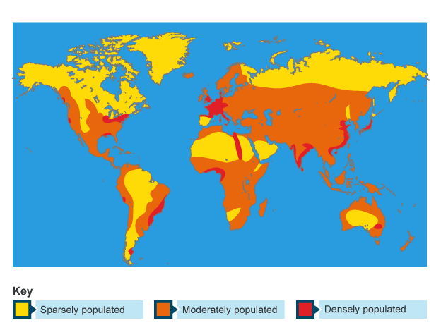
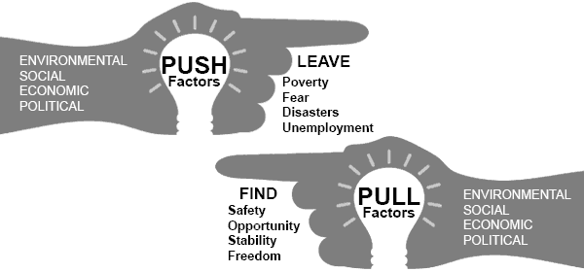
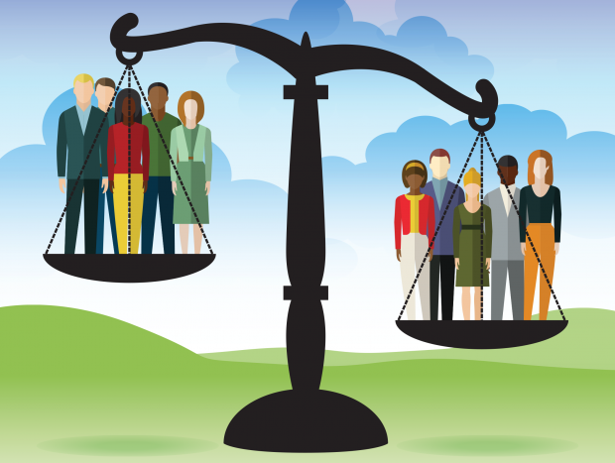
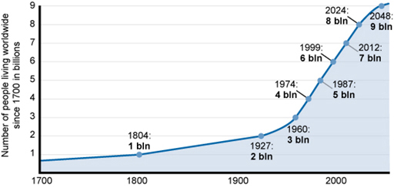
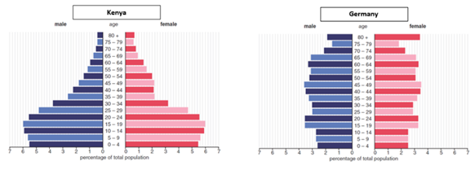


Year 7 Population
This unit focuses on the causes and impacts of changing global population. It looks at patterns of migration, impacts on cities & resources. This unit aims to consider solutions and future management of these challenges.
Game Changer – ‘I can explain how population is changing and it’s global impacts and response needed’
Population | The number of people in a place.
Densely populated | When you have a lot of people in a limited amount of space. Consequently people are close together. Measured in people per km².
Sparsely populated | When you have a small number of people in a large area. Consequently people are far apart. Measure in km².
DTM (Demographic Transition Model) | Model displaying how country’s birth rate, death rate and total population varies at different stages of development.
Population pyramid | Graph showing numbers of males and females in different age groups in a population.
Migration | Movement from one place to another.
Refugee | Someone who has been forced to flee their country because of religious persecution or war or natural disasters.
Global Population Distribution
Migration
Economic migrant: Those who enter a country with permission, mainly for employment
Refugee: Those who flee a country because of war or persecution
Illegal Immigrant: Those who enter a country without permission
Push factors: these are reasons why people leave a country.
Pull factors: these are certain things that make people want to move to an area.
Population means the number of people. Distribution is the way in which something is spread over an area. Population density is the measurement of population per km² which is split into 3 categories:
Densely populated: over 50 people per km²
Moderately populated: less than 50 people per km²
Sparsely populated: less than 10 people per km²
Factors affecting population distribution
1. Relief: the lower the land the higher the population density
2. Climate: Extreme climates are sparsely populated and moderate climates are more densely populated
3. Soil: Fertile soils attract more people so they can grow food
4. Transport: coastal areas offer access so are more densely populated than inland areas
5. Resources: more resources leads to a higher populations
6. Jobs: jobs like tourism and service industries attract population growth
Why does population grow?
The world’s population has been growing faster over the past few hundred years and is still growing rapidly although the rate is slowly down slightly. It is happening as birth rates are greater than death rates.
The population growth rate is calculated by birth rate minus death rate. Birth rate is associated with contraception, healthcare and cultural ideas. Death rate is disease, healthcare, education and pollution.
Managing Population Growth
Slowing Growth –
Government Policies
Contraception
Education
Tax Incentives
Managing Impacts –
Managing waste and water sustainably
Integrated transport networks
New housing projects
Education
Population Pyramids
A population pyramid shows the population structure of a place, dividing males and females into different age groups.
Find out more:
BBC Bitesize
Oak Academy
SPACE & PLACE | SUSTAINABILITY & STEWARDSHIP | FUTURE CHANGE & CHALLENGE | INTERRELATIONSHIPS | GAME CHANGERS

