Slide 1


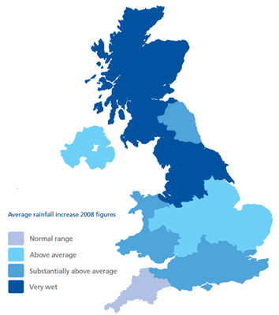

Year 9 Resource Management
This unit focuses on the resources of food, water and energy in the UK before focusing on the global challenges of water usage..
Game Changer – ‘I can recognise the challenges of resource usage in the future and how we can manage this,’
Resources such as food, energy and water are what is needed for basic human development.
Food: Without enough nutritious food, people can become malnourished. This can make them ill . This can prevent people working or receiving education. | Water: People need a supply of clean and safe water for drinking, cooking and washing. Water is also needed for food, clothes and other products. | Energy: A good supply of energy is needed for a basic standard of living. People need light and heat for cooking or to stay warm. It is also needed for industry.
Food in the UK
Growing Demand | Impact of Demand
The UK imports about 40% of its food. This increases people’s carbon footprint. There is growing demand for greater choice of exotic foods needed all year round. Foods from abroad are more affordable. Many food types are unsuitable to be grown in the UK. | Foods can travel long distances (food miles). Importing food adds to our carbon footprint. + Supports workers with an income + Supports families in LICs. + Taxes from farmers’ incomes contribute to local services. - Less land for locals to grow their own food. - Farmers exposed to chemicals.
Agribusiness | Sustainable Foods
Farming is being treated like a large industrial business. This is increasing food production. + Intensive faming maximises the amount of food produced. + Using machinery which increases the farms efficiency. - Only employs a small number of workers. - Chemicals used on farms damages the habitats and wildlife. | Organic foods that have little impact on the environment and are healthier have been rising. Local food sourcing is also rising in popularity. Reduces emissions by only eating food from the UK. Buying locally sourced food supports local shops and farms. A third of people grow their own food.
Water in the UK
Growing Demand | Deficit and Surplus
The average water used per household has risen by 70%. This growing demand is predicted to increase by 5% by 2020. This is due to: A growing UK population. Water-intensive appliances. Showers and baths taken. Industrial and leisure use. Watering greenhouses. | The north and west have a water surplus (more water than is required). The south and east have a water deficit (more water needed than is actually available). More than half of England is experiencing water stress (where demand exceeds supply).
Pollution and Quality | Water stress in the UK
Cause and effects include: Chemical run-off from farmland can destroy habitats and kills animals. Oil from boats and ships poisons wildlife. Untreated waste from industries creates unsafe drinking water. Sewage containing bacteria spreads infectious diseases.
Management | Water Transfer
UK has strict laws that limits the amount of discharge from factories and farms. Education campaigns to inform what can be disposed of safety. Waste water treatment plants remove dangerous elements to then be used for safe drinking. Pollution traps catch and filter pollutants. | Water transfer involves moving water through pipes from areas of surplus (Wales) to areas of deficit (London). Opposition includes: Effects on land and wildlife. High maintenance costs. The amount of energy required to move water over long distances.
Demand | How much of a resource is needed in an area
Supply | How much of a resource an area has available
Surplus | When the supply of a resource is greater than the demand
Deficit | When the demand for a resource is greater than the supply.
Water insecurity | A lack of a safe and reliable source of water.
Water stress | Where demand for water in an area exceeds supply
Energy in the UK
Growing Demand | Energy Mix
The UK consumes less energy than compared to the 1970s despite a smaller population. This is due to the decline of industry. | The majority of UK’s energy mix comes from fossil fuels. By 2020, the UK aims for 15% of its energy to come from renewable sources. These renewable sources do not contribute to climate change.
Changes in Energy Mix
75% of the UK’s oil and gas has been used up. Coal consumption has declined. UK has become too dependent on imported energy.
Find out more:
BBC Bitesize
Case Studies
 | Oil |  | Gas |  | Renewable
 | Nuclear |  | Coal |  | Other
SPACE & PLACE | SUSTAINABILITY & STEWARDSHIP | FUTURE CHANGE & CHALLENGE | INTERRELATIONSHIPS | GAME CHANGERS

