Slide 1

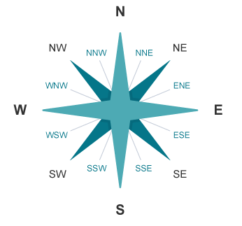
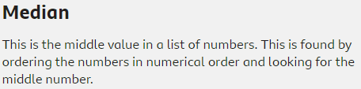
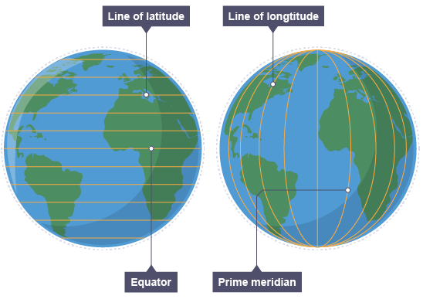


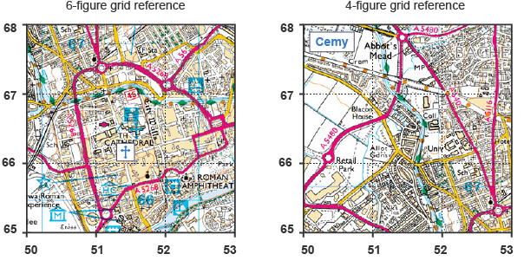



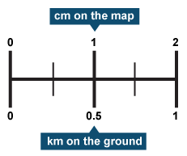
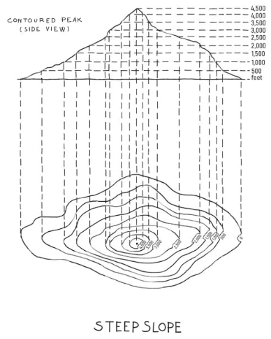
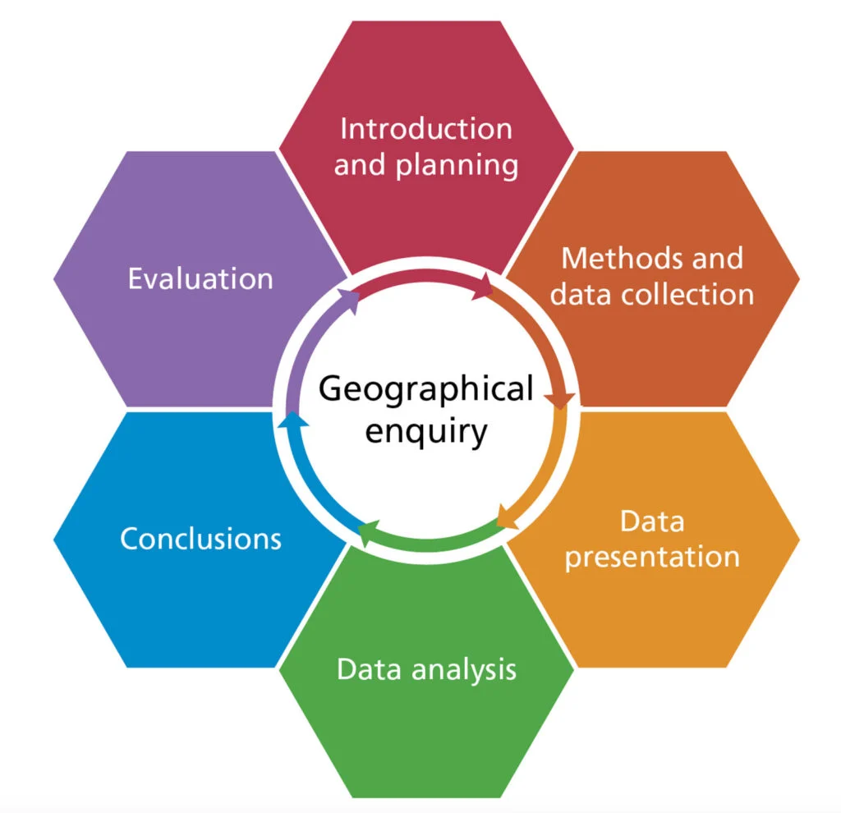

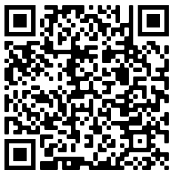
Year 9 Skills
This unit focuses on the key geographical skills required for the GCSE. Building on KS3 cartographic skills whilst developing numerical and GCSE technique skills.
Game Changer – ‘I can use a range of geographical skills to understand space & place.’
Continent | One of the seven large land masses of the earth
Country | A nation with its own government occupying a particular territory
Longitude | The lines down the earth showing east or west
Latitude | The lines across the earth showing north and south
Contour Lines | Brown lines on a map which show height
Relief | The height of the land
OS Map | Ordnance Survey is a map of areas of the UK
Cartographic Skills
Numerical Skills
Maps should have a direction arrow to show which way is north. From this you can work out other directions. Speak like a geography use compass points to locate places.
Data can be measured in a number of different ways, for example:
Latitude and longitude enable users to find locations around the globe.
Lines of latitude run from east to west. The Equator is a line of latitude that lies at 0°. Lines of longitude run from north to south. The Prime or Greenwich Meridian in London is a line of longitude at 0°.
Four-figure grid references locate a place or object within a grid square. Six-figure grid references locate a place or object within a specific part of a grid square.
Most maps have a scale. These help us to work out distances on maps. This is given by the scale statement (eg 1:25,000) and/or by showing a scale bar.
Contour lines are drawn on maps that join places of the same height. They are usually an orange or brown colour. Some contour lines have their height above or below sea level written on them.
GCSE Extended Writing
Structuring you extended writing.
K
Knowledge – Specific and relevant case study examples
Understanding – Explanation using connectives of these examples in relation to the question.
Application – Links and conclusion drawn to respond to the questions focus.
Fieldwork
An enquiry is a question that you set out to prove or disprove. A hypothesis is very similar, though it is a statement rather than a question. Both can be either physical or human in nature:
physical enquiries will look at natural landscapes, eg rivers or coasts
human enquiries will look at environments that are created by people, eg cities or tourist resorts
U
Find out more:
A
BBC Bitesize
AQA Skills List
Basic
Clear
Detailed
SPACE & PLACE | SUSTAINABILITY & STEWARDSHIP | FUTURE CHANGE & CHALLENGE | INTERRELATIONSHIPS | GAME CHANGERS

