Slide 1


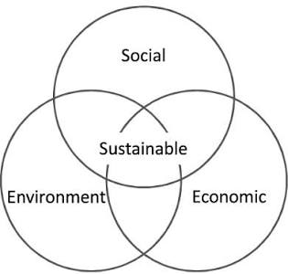

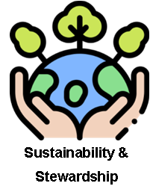
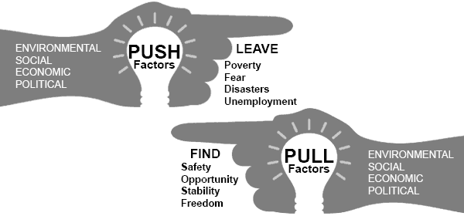
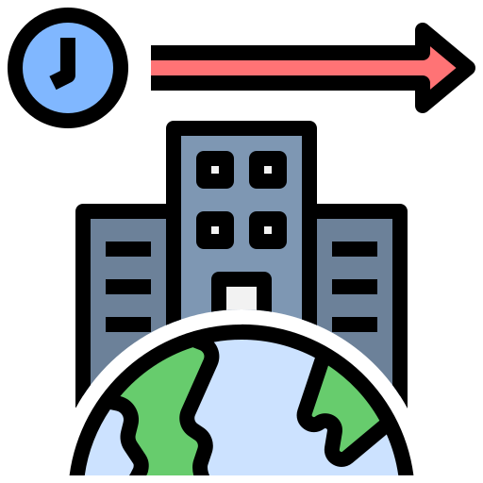
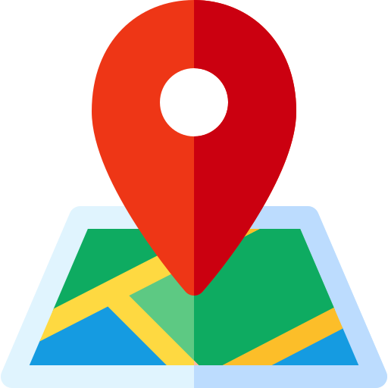
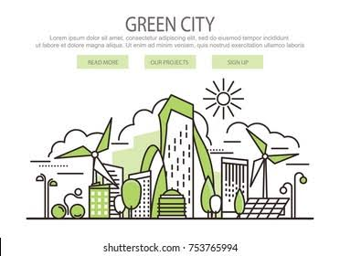
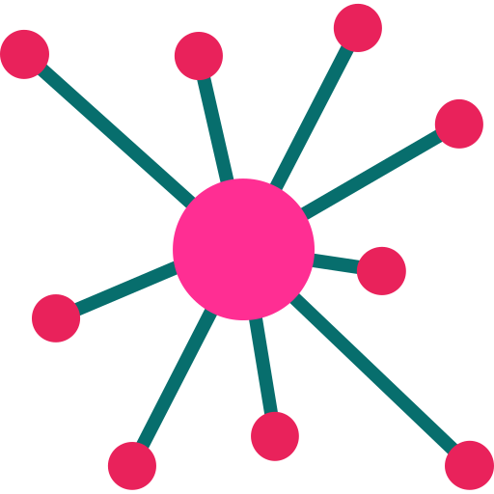
Urban Sustainability
Weather & Climate: How do we respond to climate change?
Sustainability
Urbanisation
Sustainability | Meeting our needs today without ruining or running out of resources for future generations.
Urbanisation | The increase in the percentage of people living in towns and cities.
Megacity | A city with a total population of over 10 million people
Brownfield | Land that has been built on before and is now derelict, abandoned, or ready to be redeveloped.
Greenfield | An area of open countryside or farmland that has never been built on before.
Air Pollution | Harmful gases, dust, and smoke released into the atmosphere, making the air dirty and unsafe to breathe.
Smog | A heavy, dangerous fog caused by a mixture of air pollution, smoke, and mist.
Water Pollution | The contamination of rivers, lakes, and oceans by harmful chemicals, trash, or sewage.
Congestion | Traffic jams caused when too many vehicles use the same roads at the same time, slowing down travel.
Carbon Footprint | The total amount of greenhouse gases (like carbon dioxide) produced by a person's everyday actions, choices, or products.
Around 56% to 58% of the world's population lives in urban areas and this continues to grow.
Balancing:
Social – People’s needs
Economic – Money/job needs
Environment – Planet’s needs
The population of cities usually changes in one of two ways:
Natural increase (or decrease) - this is the difference between the number of births and the number of deaths.
Migration - this is the movement of people into or out of the city.
What does sustainability mean?
If something is sustainable, it can be carried on for a long period of time.
Being sustainable means doing little or no harm to the environment.
Throwing plastic bags away is not sustainable because the planet will eventually run out of landfill space.
Future Change &
Challenge
Space & Place
 | Water Pollution | Air Pollution | Congestion
Causes | Poor management of sewage & wastewater Pollutants, metals, oil, and microplastics getting directly into waterways. | Vehicle exhausts Burning fossil fuels. Power generation, manufacturing, and construction dust. | Inadequate public transport Reliance on cars Inefficient Road Networks Poor urban planning
Solution | Managing water supply Treating waste water Fining polluters | Clean Air Zones Move to use more electric vehicles Greater use of renewable energy Fining polluters | Investment in public transport Bike and car sharing schemes Congestion charges
Eco Cities
To tackle the challenges of urban growth and to create more sustainable ways of living some countries are developing eco cities.
These are designed to be sustainable.
Interrelationships
Key Features
Renewable Energy: Uses solar, wind, and waste-to-energy systems to cut emissions.
Sustainable Transport: Prioritizes walking, cycling, electric public transit, and car-sharing over personal vehicles.
Green Spaces: Integrates parks, vertical greenery, and green roofs to lower temperatures and boost biodiversity.
Future Change &
Challenge
Up Next – Ecosystems (Year 8)
How can we manage natural environments sustainably?

