Slide 1

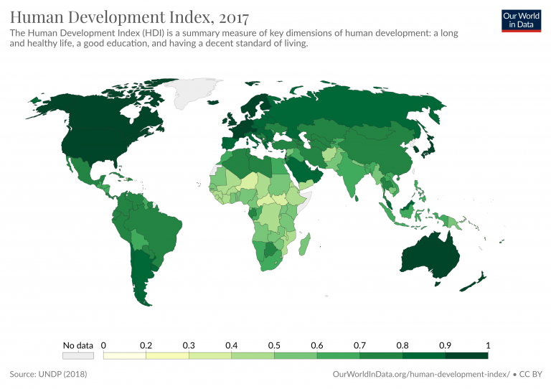
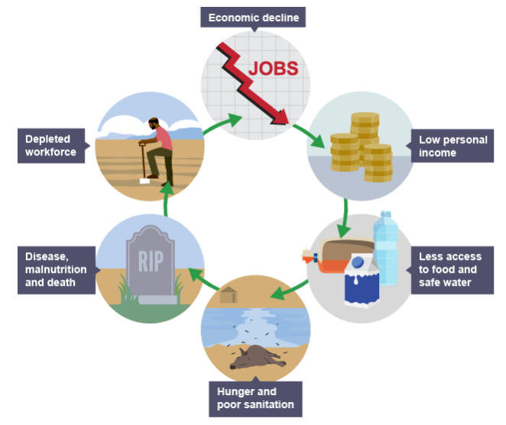
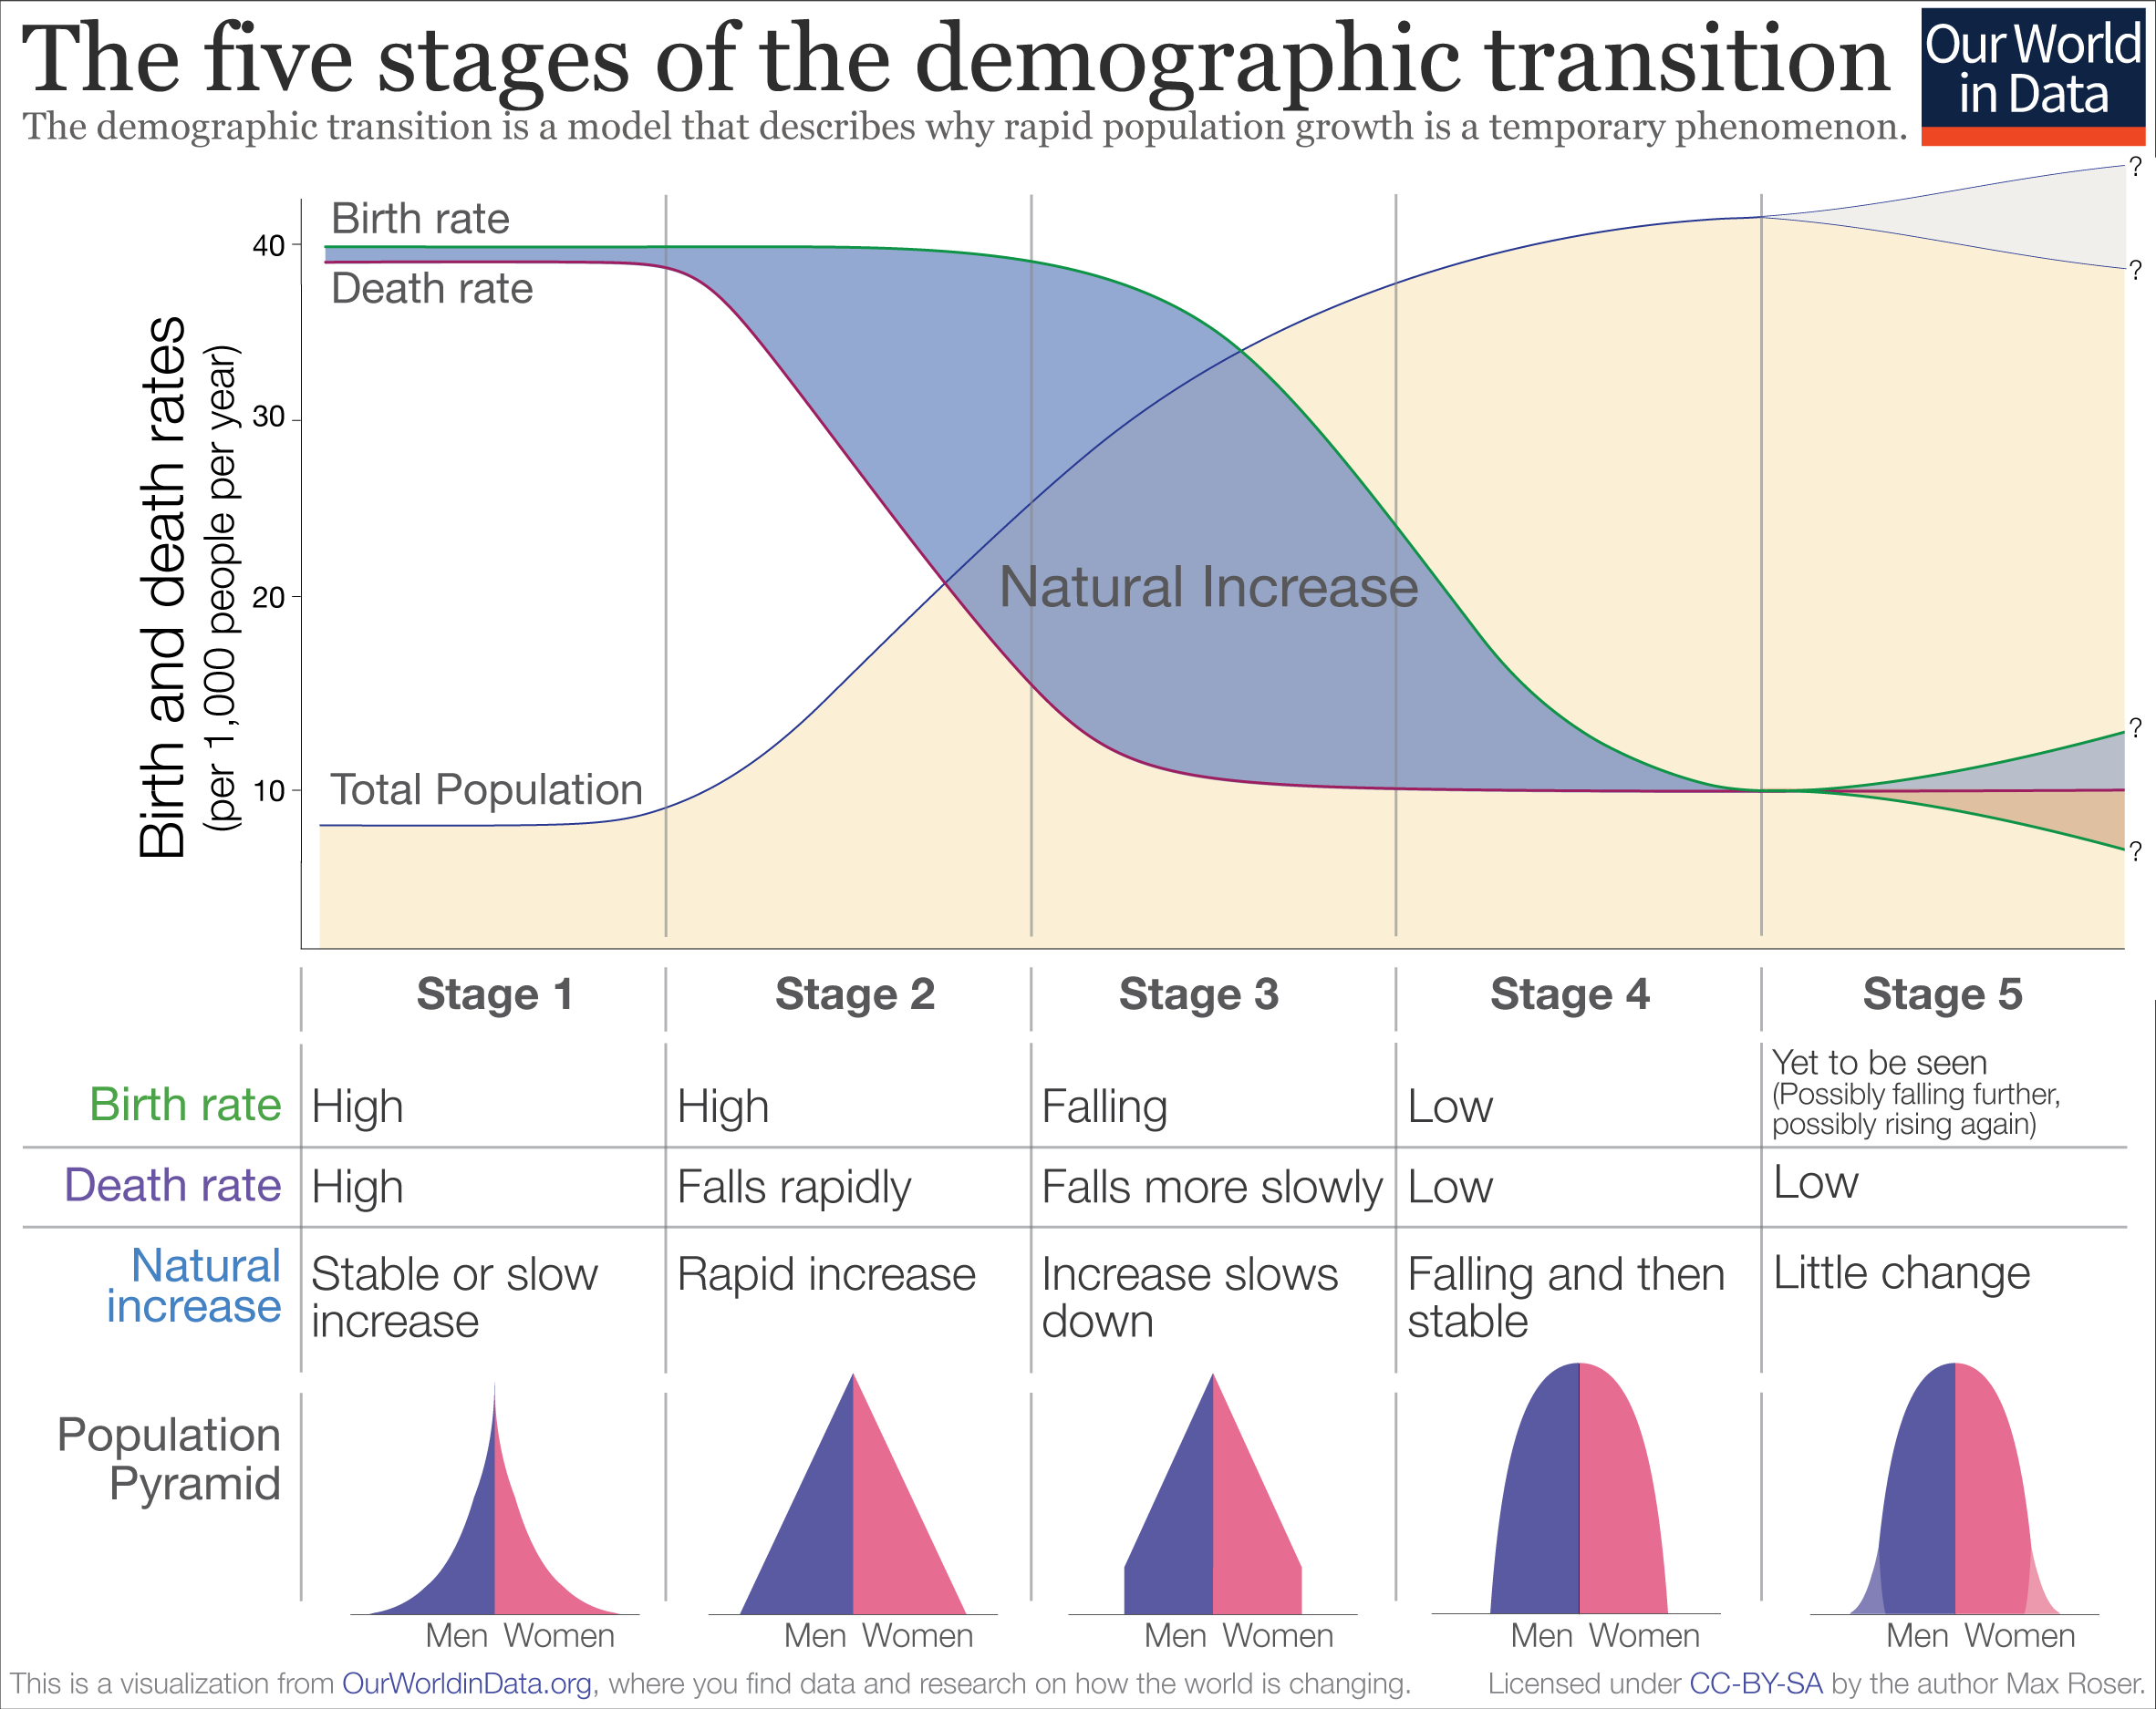
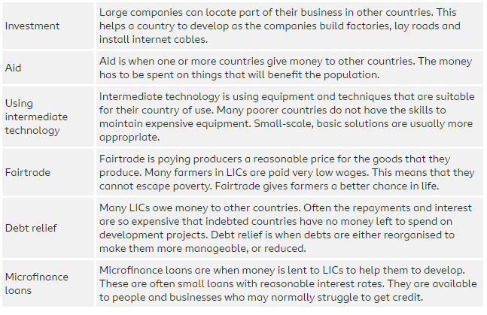
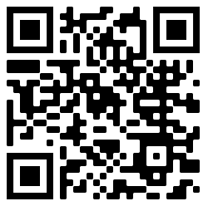
Year 11 Economic World
This unit focuses on the contrasting development around the globe, how we identify this and the impacts of uneven development. Methods to improve development will be explored and evaluated.
Game Changer – ‘I can identify factors that affect a countries development and offer solutions.’
Development | Means people reaching an acceptable standard of living or quality of life.
HIC | High Income Country
NEE | Newly Emerging Economy
LIC | Low Income Country
GDP | The total value of goods and services produced by a country in a year.
GNP | Measures the total economic output of a country, including earnings from foreign investments.
Gross National Income (GNI) per capita | Gross national income per person. The value of a country's income, divided by the number of people in that country.
Life expectancy | The average number of years a person is expected to live in a particular place.
Measuring Development
Uneven Development
Economic and social indicators of development: such as Gross National Income (GNI) per capita, GDP, GNP as economic indicators and life expectancy, infant mortality, death rate and literacy rate.
Limitations of economic and social measures.
Physical, economic and historical causes of uneven development with examples: e.g. Extreme weather and unlocked countries in Africa as physical cause, world trade is dominated by wealthier countries as economic cause, colonialism as historical cause.
Inequalities of wealth & health and international migration as a consequences of uneven development.
Demographic Transition Model & Population Pyramid
DTM to show changes of population of a country over the time.
The link between DTM and level of development in a country.
Changing population structures (population pyramids) and link this to different stages of DTM.
Reducing the development gap
There are lots of ways that can help to reduce the development gap.
Find out more:
A countries population structure can be displayed in a population pyramid. These have female populations on the right and male on the left. The bars represent the population in each age category labelled in the centre of the graph.
Developed countries have large elderly populations and lower birth rates so are less pyramid and more oval and rounded. The UK is at stage 4 of the DTM and therefore has an aging population and a rounded shape population pyramid.
BBC Bitesize
Case Studies
SPACE & PLACE | SUSTAINABILITY & STEWARDSHIP | FUTURE CHANGE & CHALLENGE | INTERRELATIONSHIPS | GAME CHANGERS

